Slide 1
Version Control: Not Just for Software
Lab Meeting – 2024.1.18

Slide 2
What is Version Control?
“Version control systems are software tools that help software teams manage changes to source code over time.”
“VC software keeps track of every modification to the code in a special kind of database.”
Integral for collaboration – how to handle multiple people editing the same file, potentially changing the same things!
Quotes from Atlassian git tutorial, emphasis mine

Slide 3
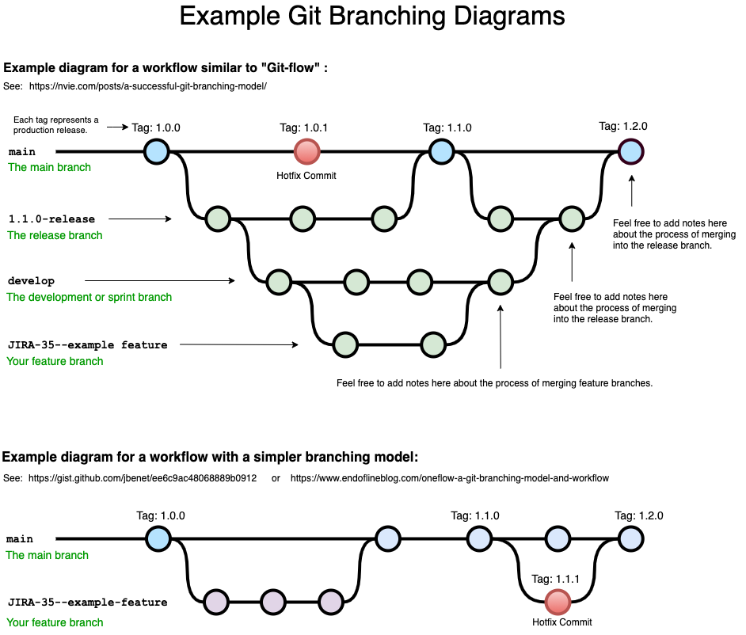
Benefits
Complete change history
control over change logs
Can rollback to earlier versions at any time
Branches, and their associated merging
This is how parallel editing is managed
will get into later
Cloud storage
Image from Bryan Braun

Slide 4



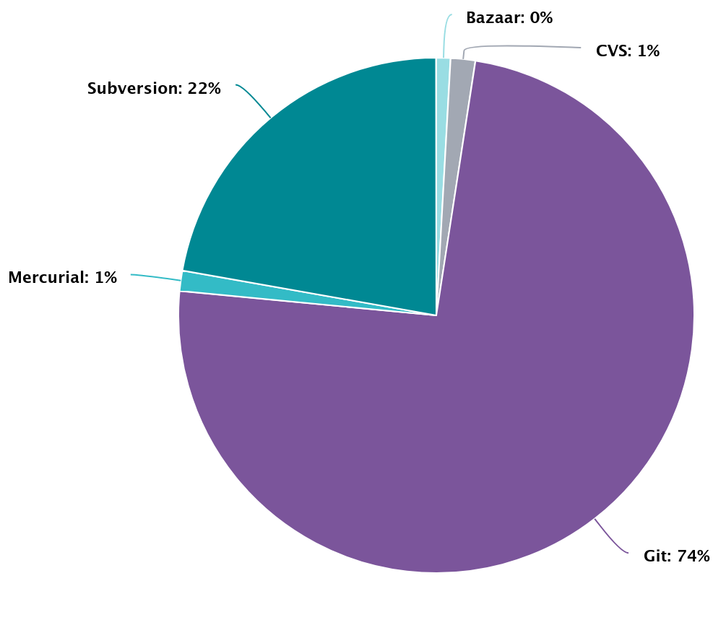




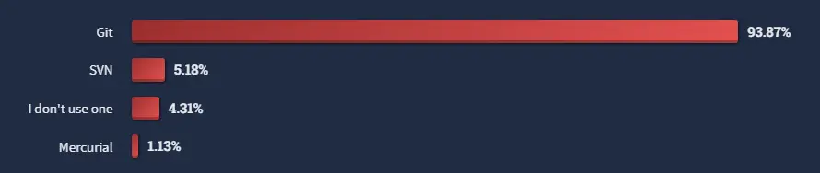
+
Most popular and widely-used version control software
Developed in ~10 days by Linus Torvalds (inventor of Linux)
Is a “distributed” version control system
Everyone has a remote copy
Solves the political issue of “who can make changes”
Awesome GUI and associated website (github.com) makes it easy to collaborate and share repositories.
Openhub.net
Stackoverflow user interview January 2023
Notes:
Openhub is platform aimed at indexing the open-source software development community.

Slide 5
Definitions
Repo(sitory) – a specific, version-controlled project (e.g. wrh.scRNA, mIHCScripts, mIHC, etc.)
Branch – a specific version of a repository
Remote vs. local
Feature branches
Command line – a mouse-less interface
Move, copy, open files (just like in Finder)
Run commands (similar to clicking an icon to open it)
Github/gui – graphical user interface
Github is not required to use git or version control, but it’s helpful!

Slide 6
How I use git
R package development
Tracking code used for specific projects/data
Sharing code
Easily switch between working on my local computer, the galaxy supercomputer, and exacloud

Slide 7
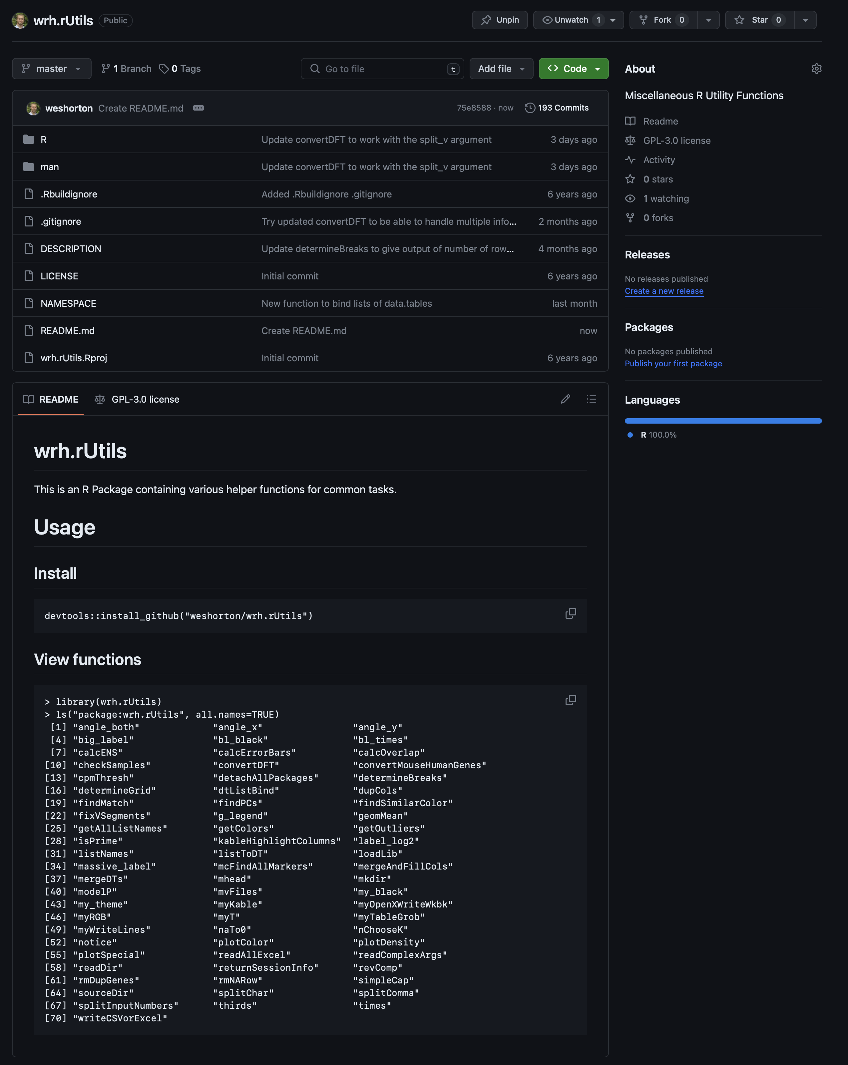
R Package Development
Hosted online so I can collaborate with anyone
Can quickly see the latest change in each file
Look at my entire commit history
Tracking, sharing, and switching computers are all also used for this!

Slide 8
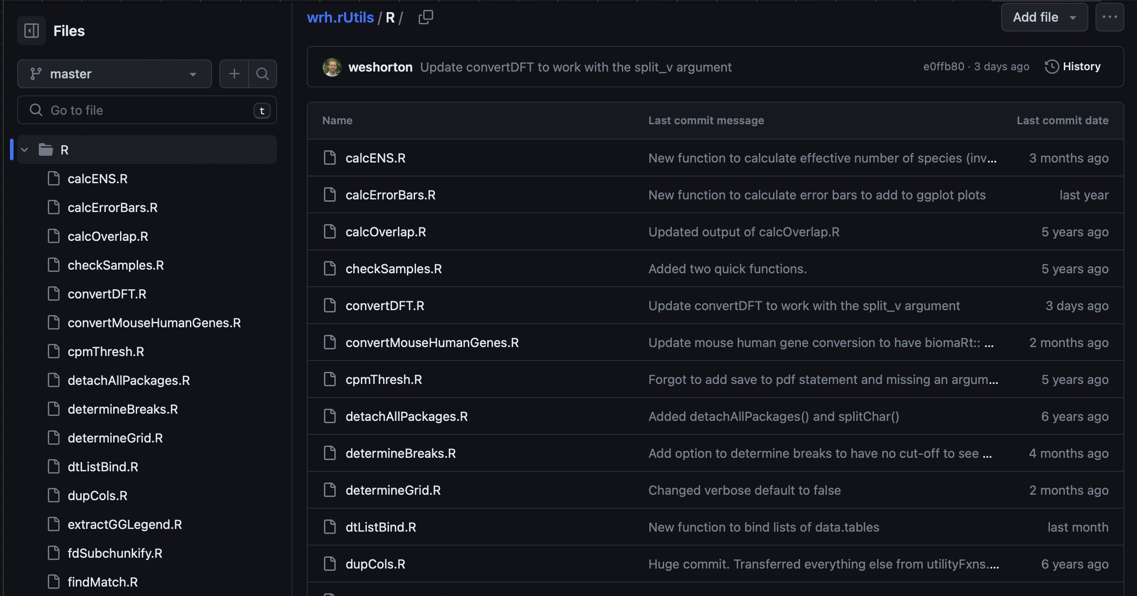
R Package Development
Hosted online so I can collaborate with anyone
Can quickly see the latest change in each file
Look at my entire commit history

Slide 9
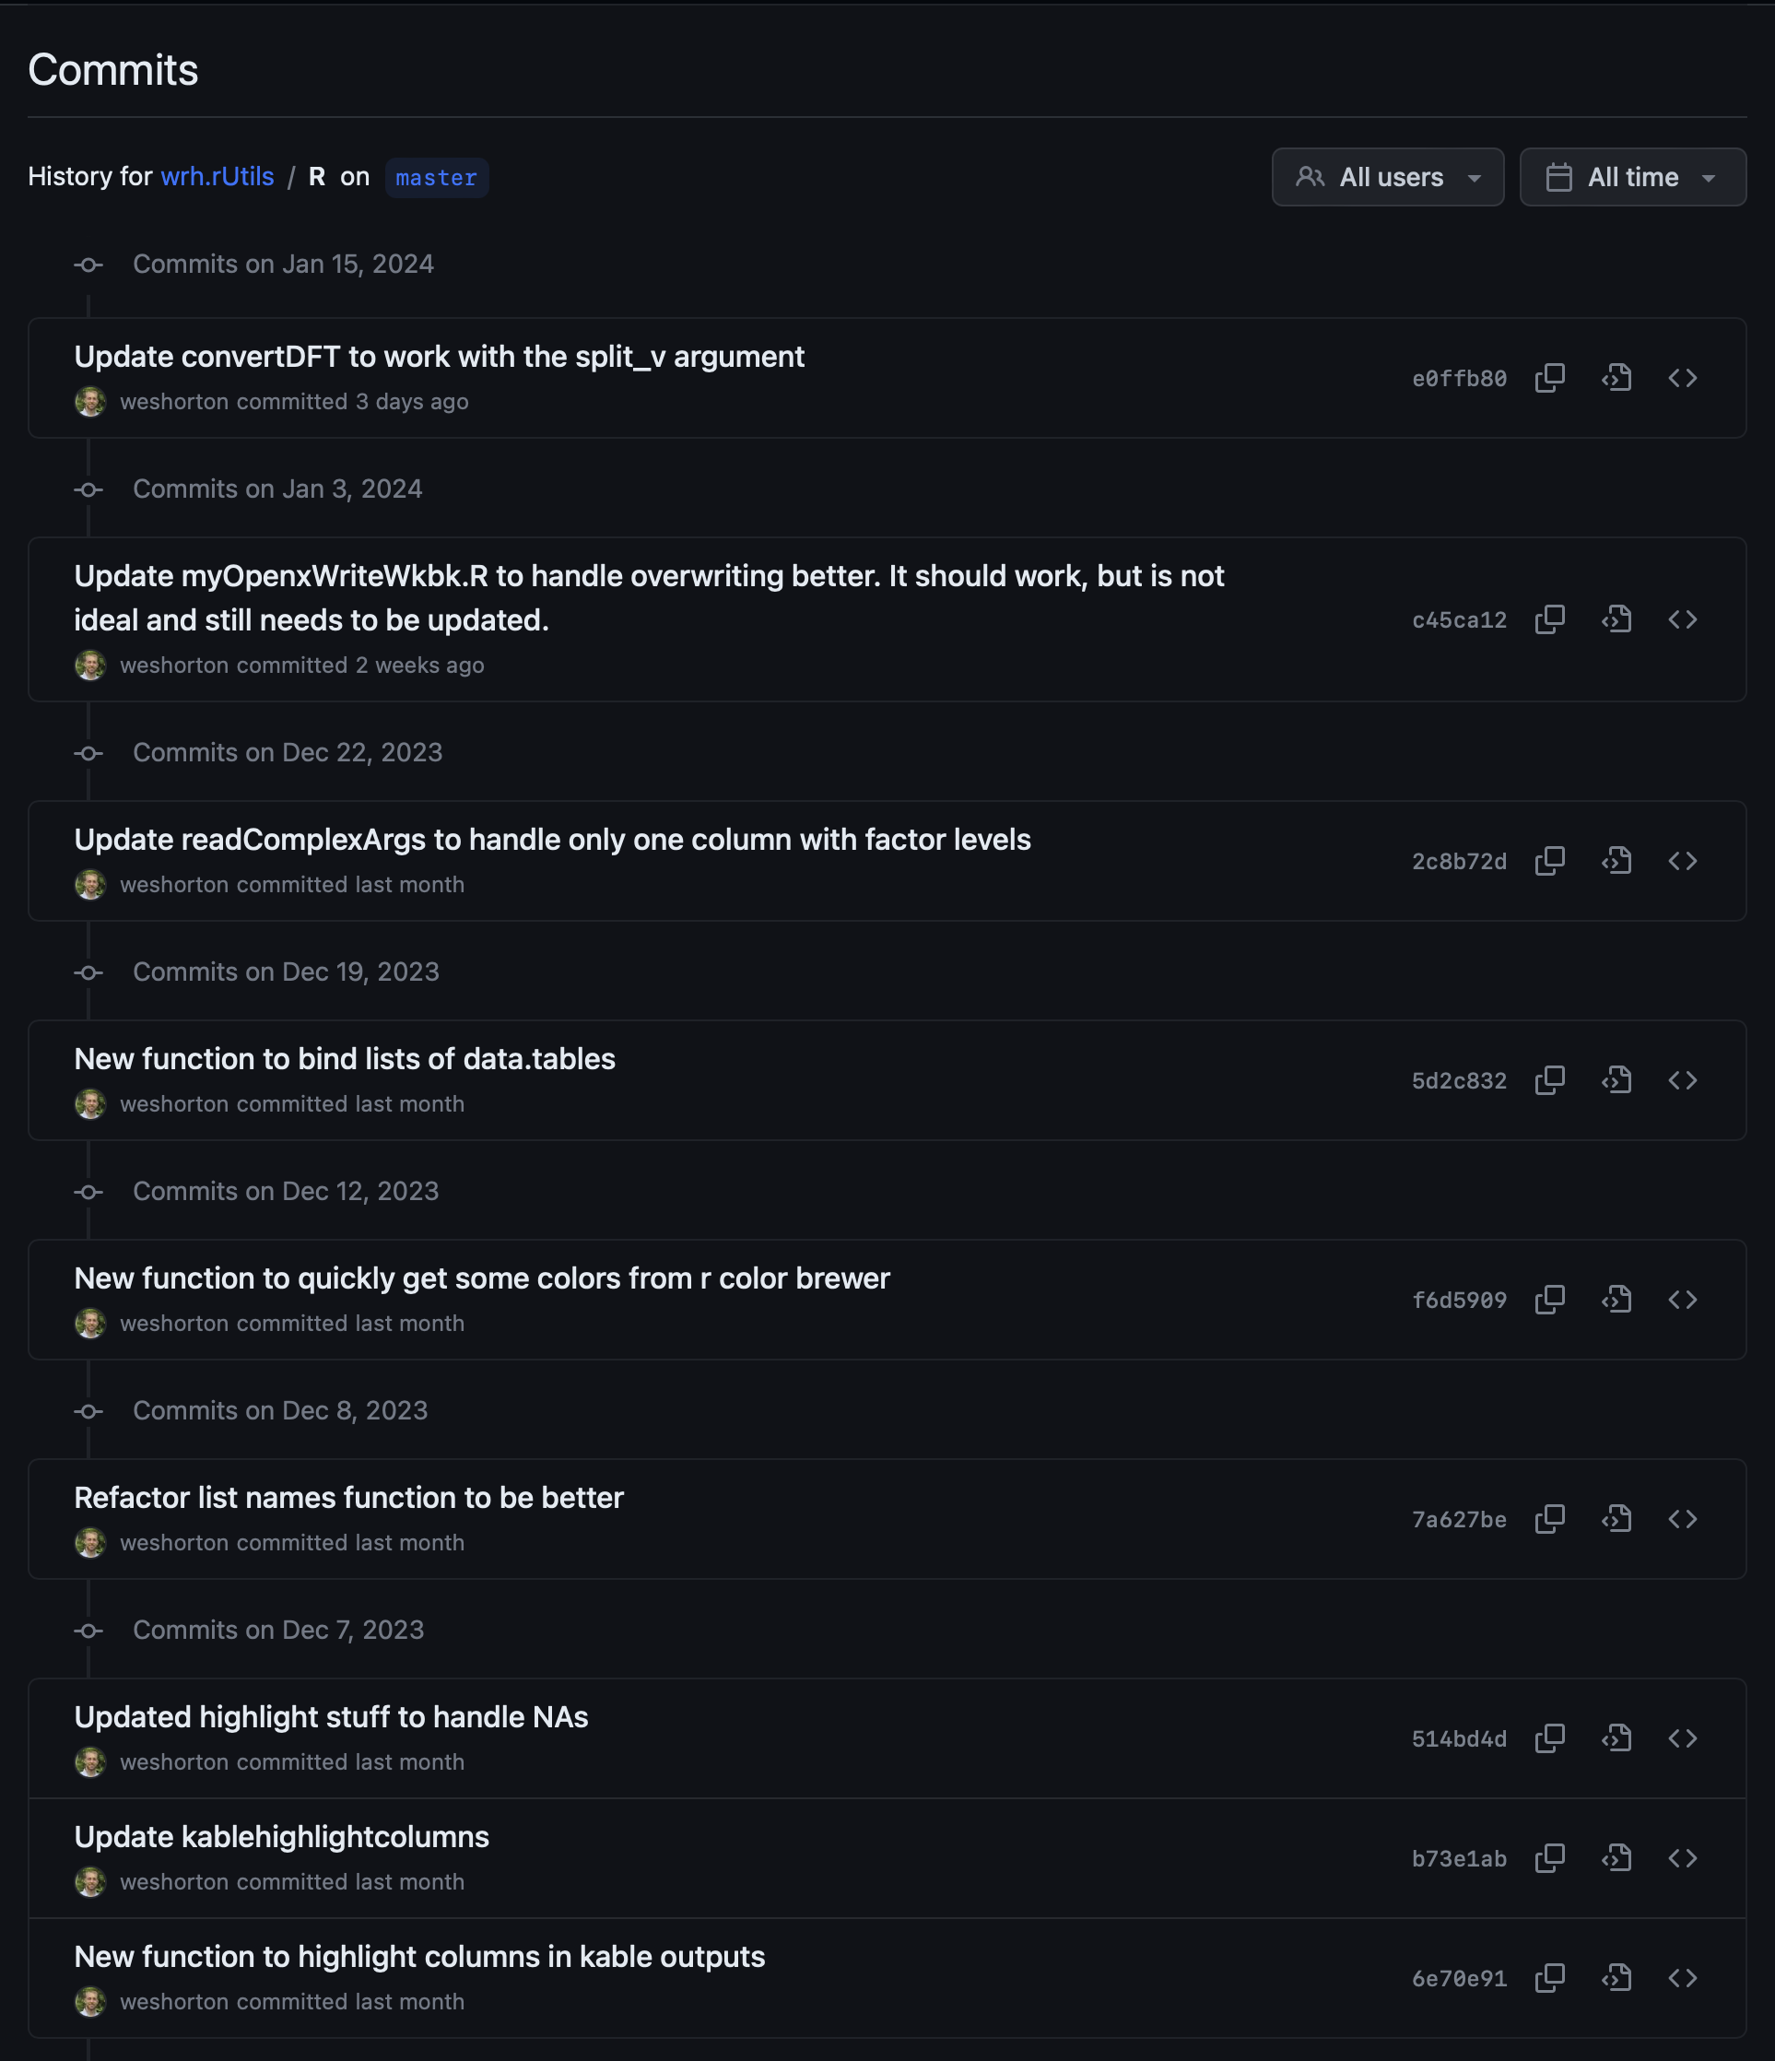
R Package Development
Hosted online so I can collaborate with anyone
Can quickly see the latest change in each file
Look at my entire commit history

Slide 10
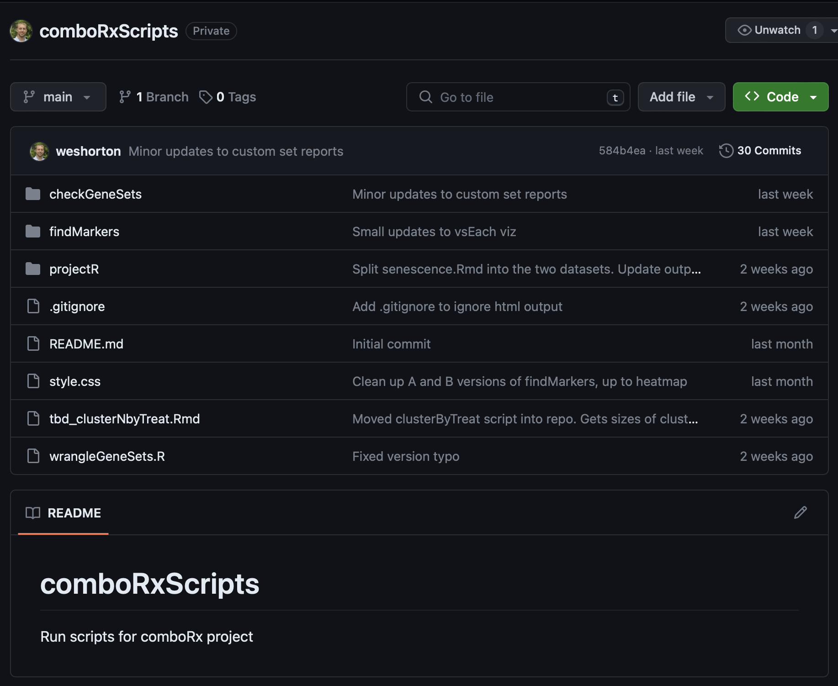
Tracking Code
Track updates as I work on the combo project
See when we started using a newer version of the custom gene sets
See when new mIHC projects were added and run

Slide 11
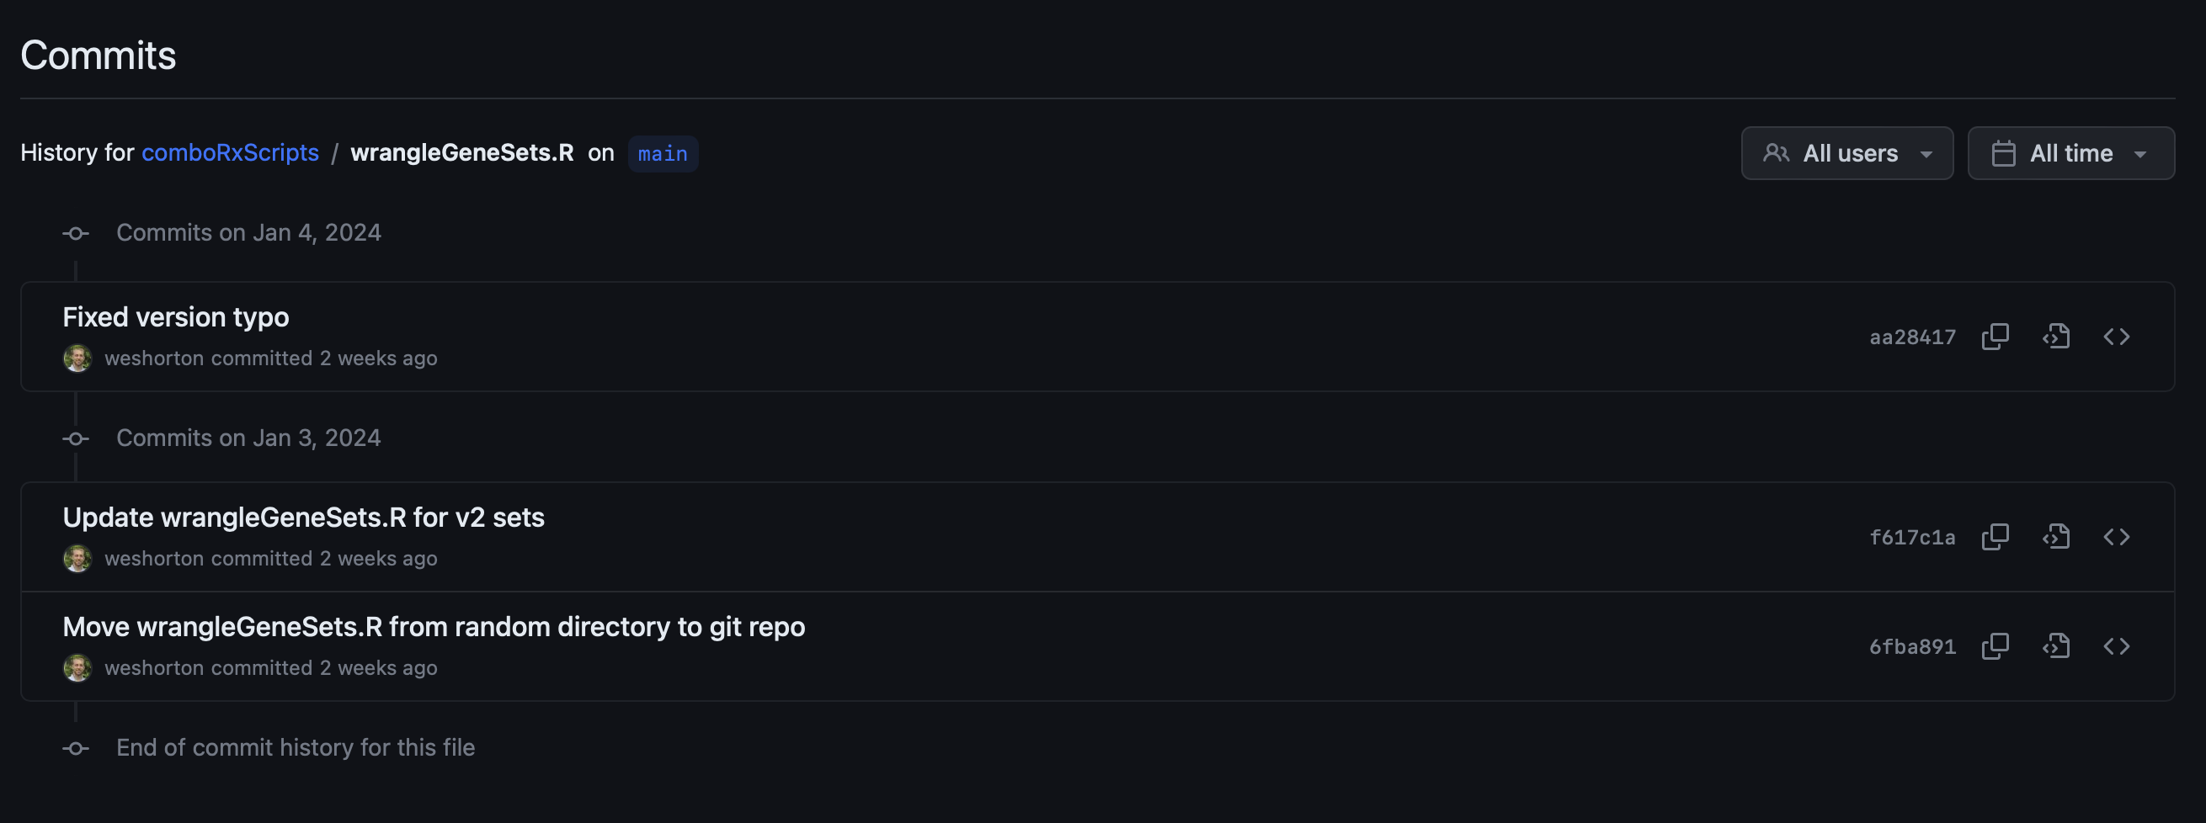
Tracking Code
Track updates as I work on the combo project
See when we started using a newer version of the custom gene sets
See when new mIHC projects were added and run

Slide 12
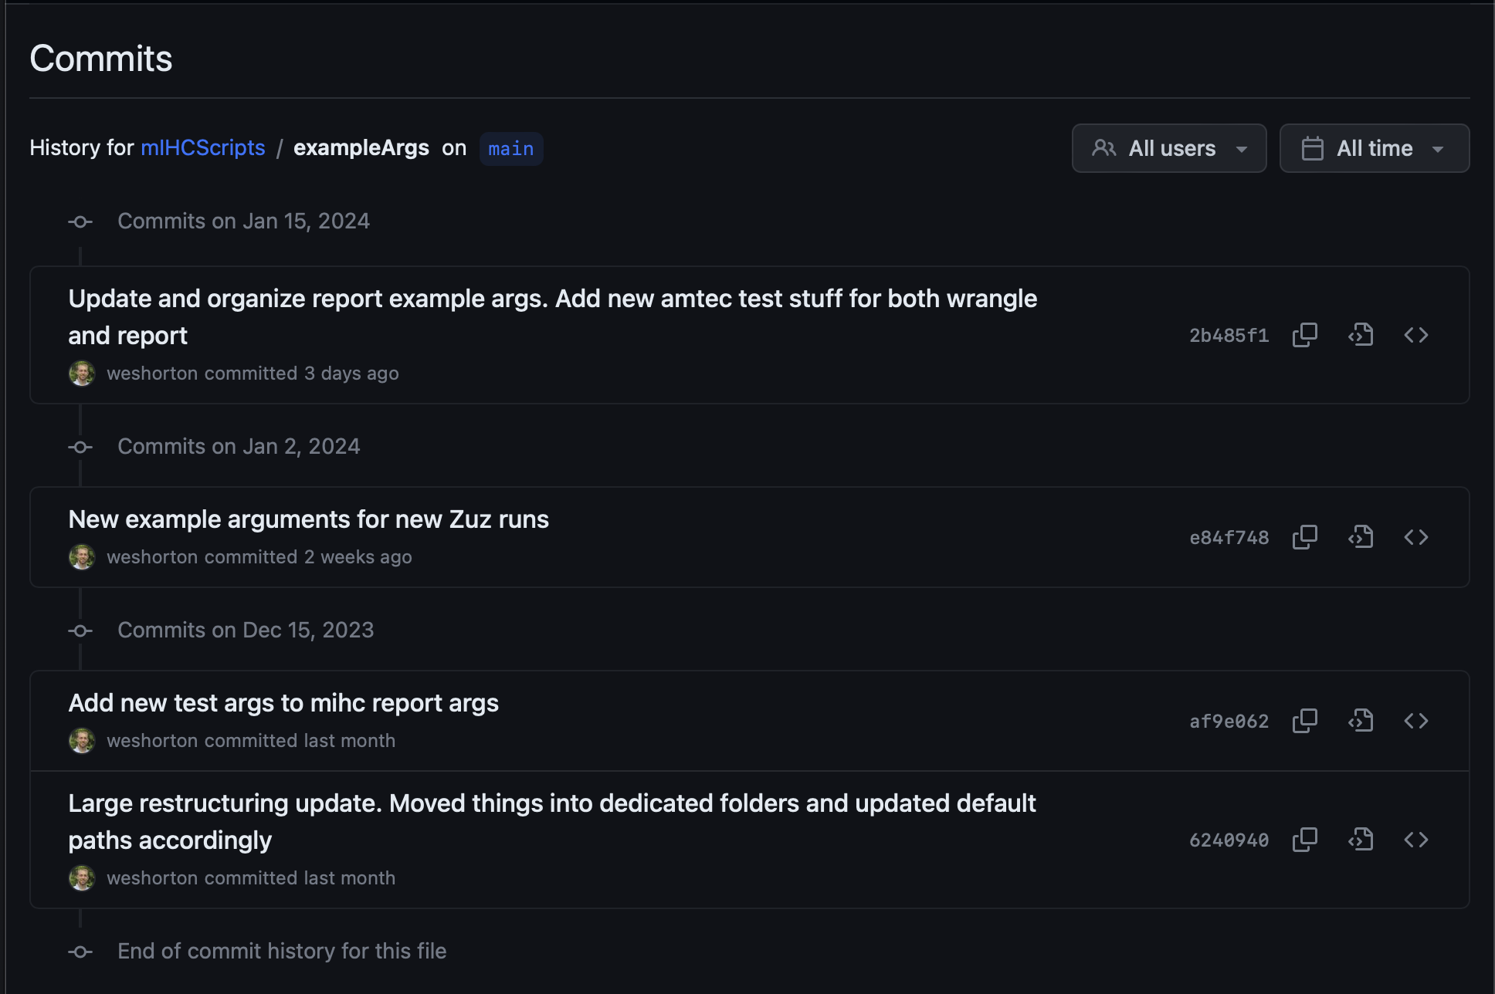
Tracking Code
Track updates as I work on the combo project
See when we started using a newer version of the custom gene sets
See when new mIHC projects were added and run

Slide 13
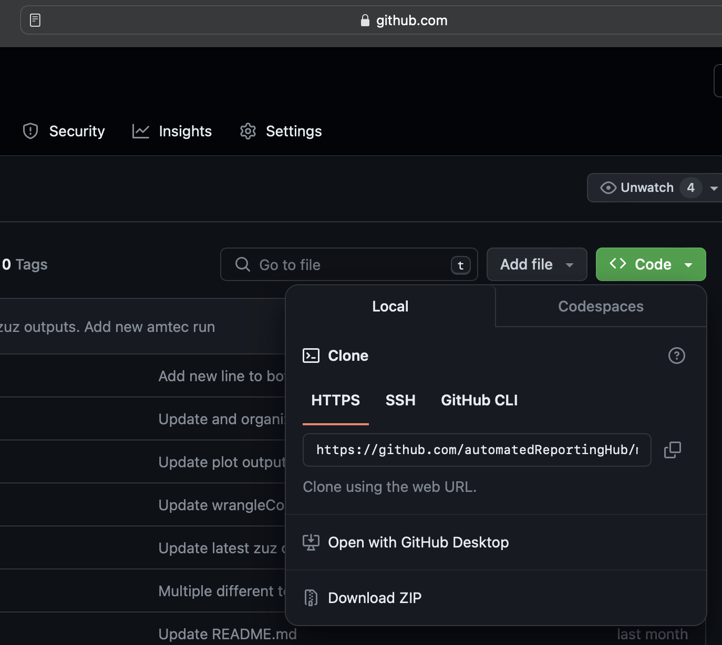
Sharing Code/Switching Locations
Anyone with a link and permission can access your repository
Share instructions, descriptions of the data, etc.
Have the exact same versions in multiple locations

Slide 14
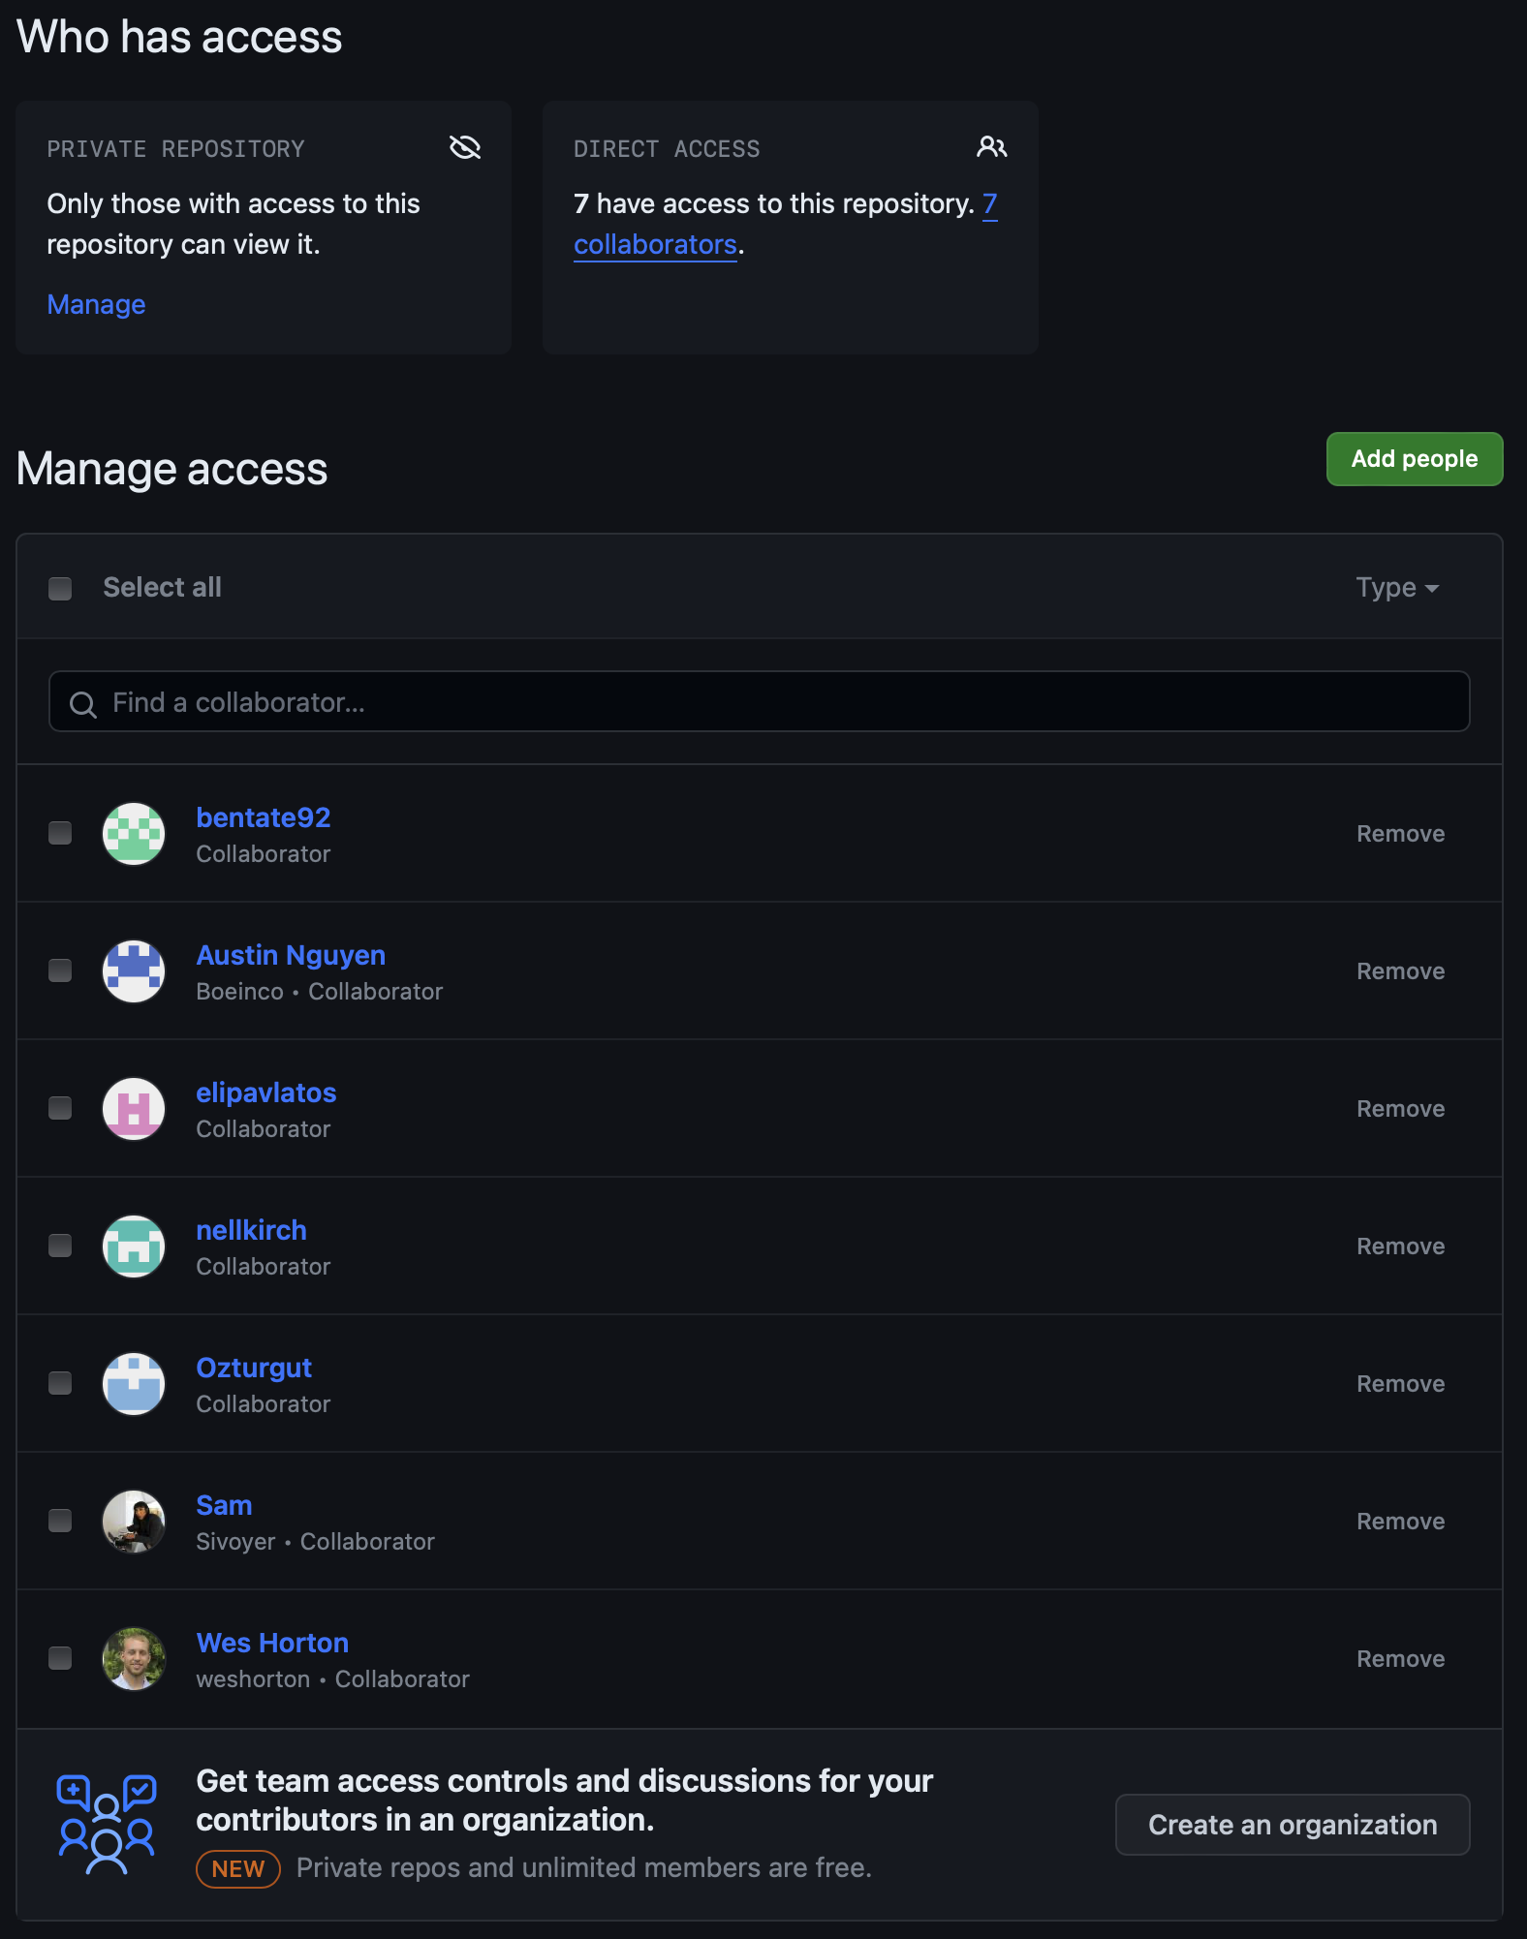
Sharing Code/Switching Locations
Anyone with a link and permission can access your repository
Share instructions, descriptions of the data, etc.
Have the exact same versions in multiple locations

Slide 15
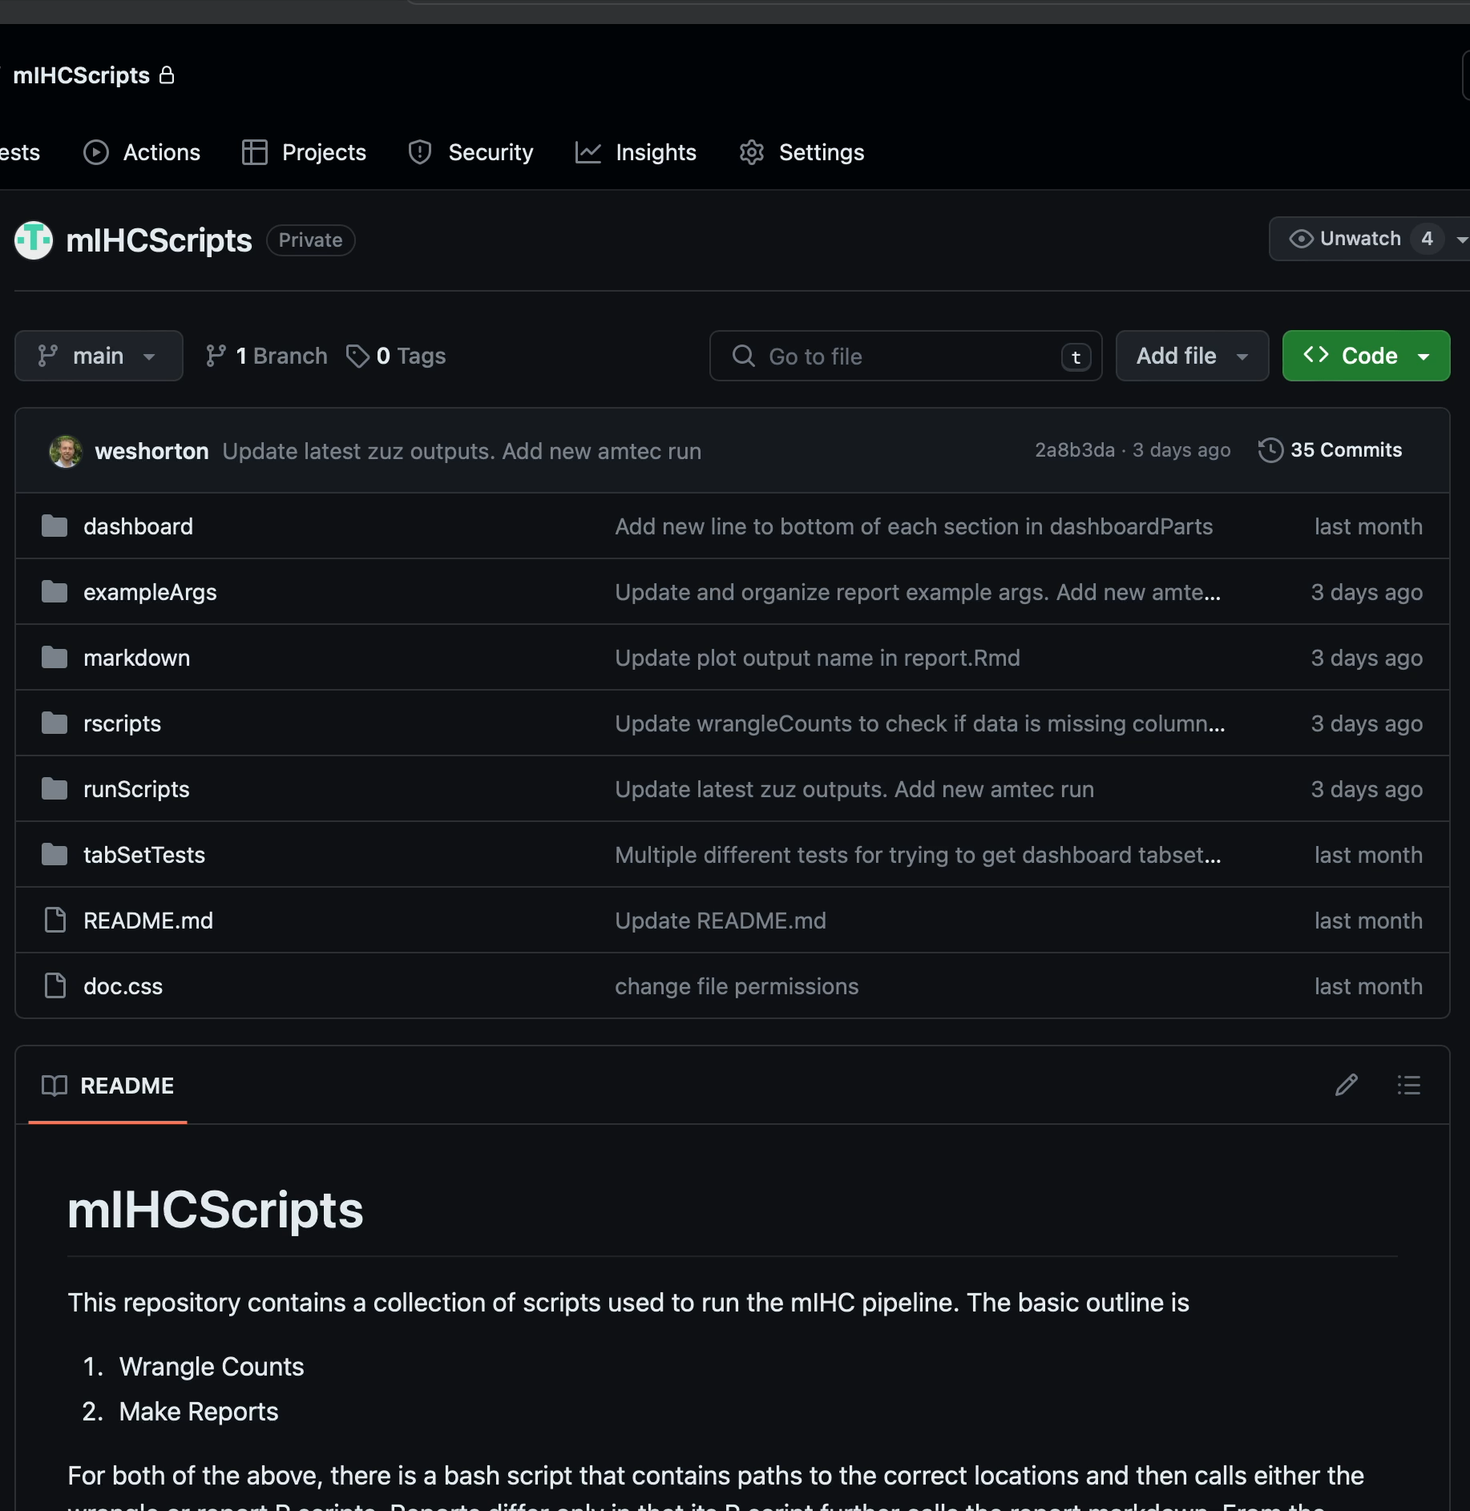
Sharing Code/Switching Locations
Anyone with a link and permission can access your repository
Share instructions, descriptions of the data, etc.
Have the exact same versions in multiple locations

Slide 16
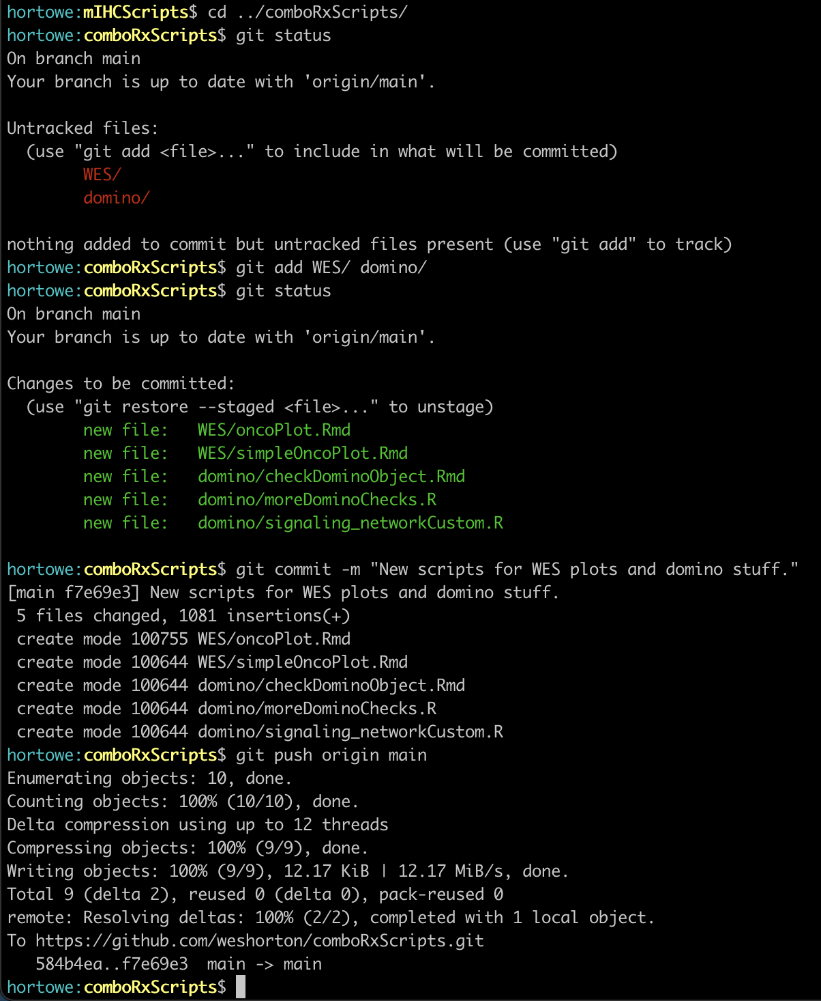
Sharing Code/Switching Locations
On my local computer:
Make new files
Anyone with a link and permission can access your repository
Share instructions, descriptions of the data, etc.
Have the exact same versions in multiple locations
Write a comment describing what you did
Upload your changes

Slide 17
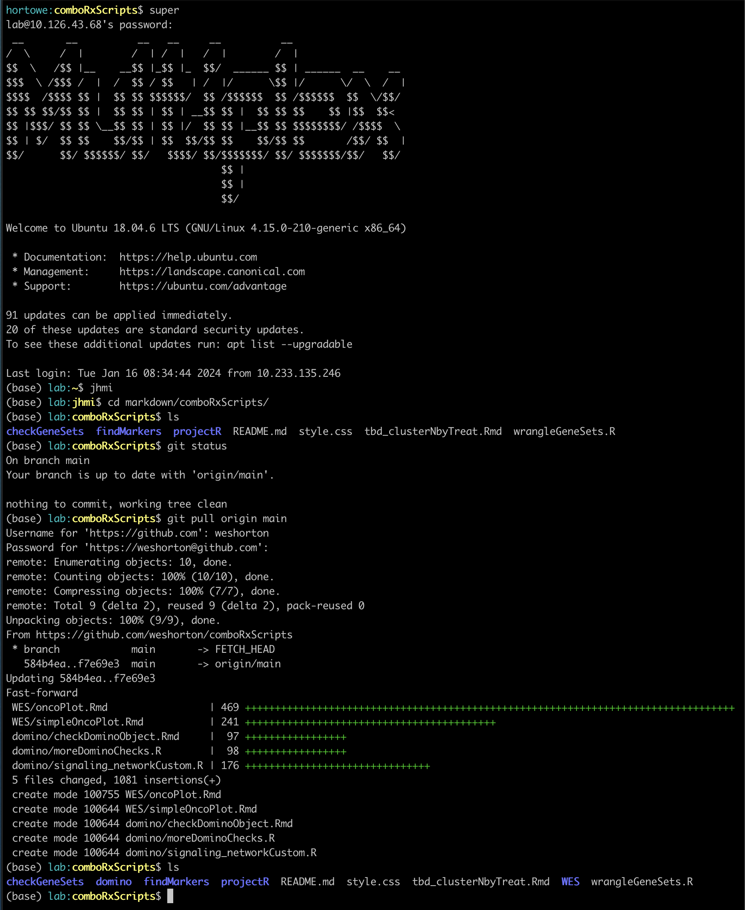
Sharing Code/Switching Locations
On the galaxy supercomputer:
Log in
Anyone with a link and permission can access your repository
Share instructions, descriptions of the data, etc.
Have the exact same versions in multiple locations
Review repository and see that WES and domino are missing
Download the changes

Slide 18
How you can use git
Track excel sheets
Track manuscripts
Track data versions
No more
document_dateXX1_WHedit
document_dateXX2_APedit
Document_dateXX2_AP_WHedit

Slide 19
How you can use git
Track excel sheets
For example the custom gene sets that Amanda gave me for the scRNAseq project. Instead of using version numbers/dates, can just update
Track manuscripts
Word does pretty well for track changes, but can have more detailed change logs using git
Track data versions
Log where data came from and details (more information than just the created-by date)
No more document_dateXX1_WHedit; document_dateXX2_Apedit; etc.

Slide 20
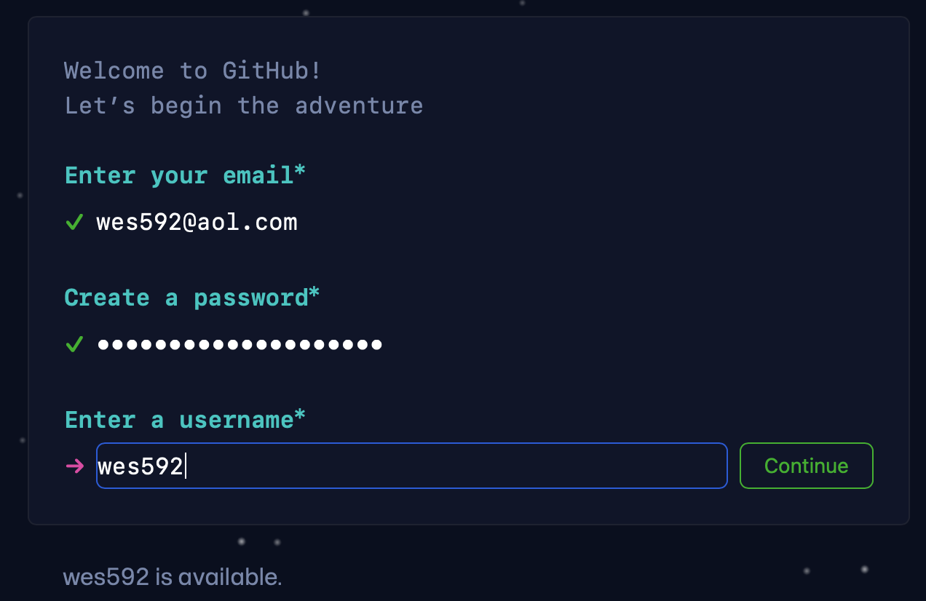
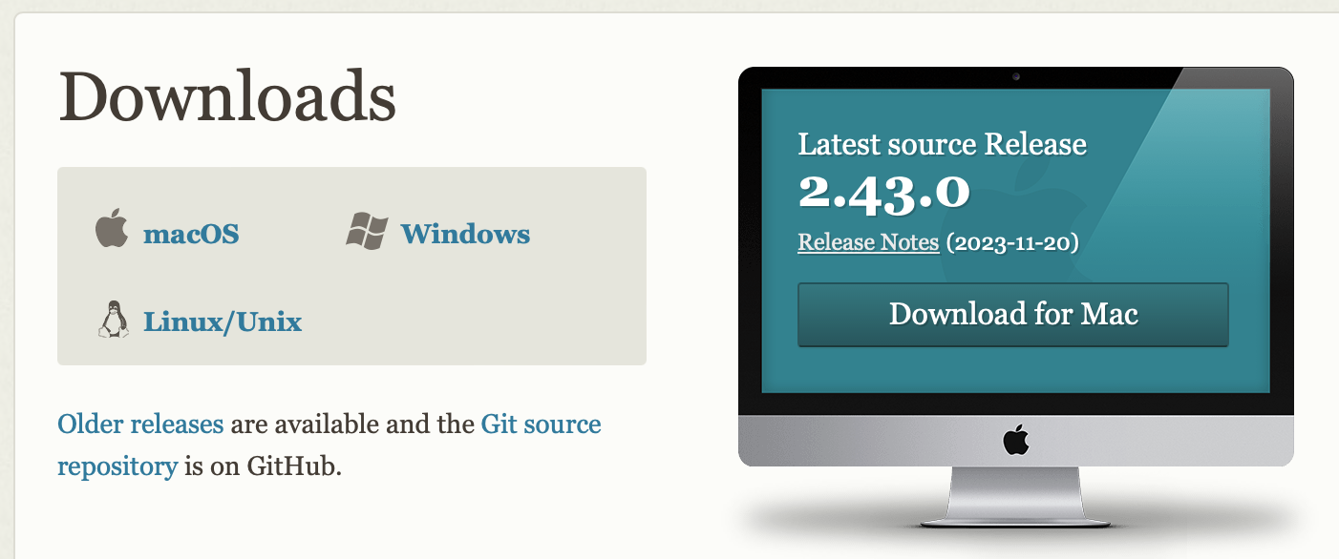
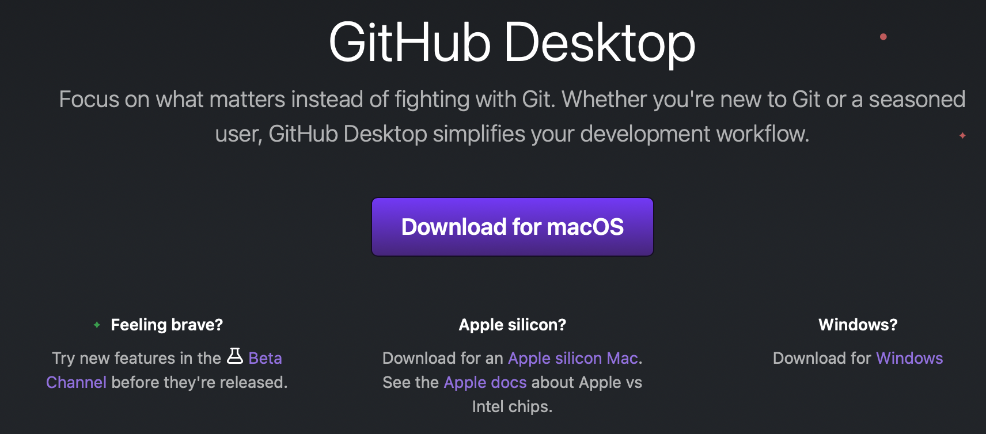
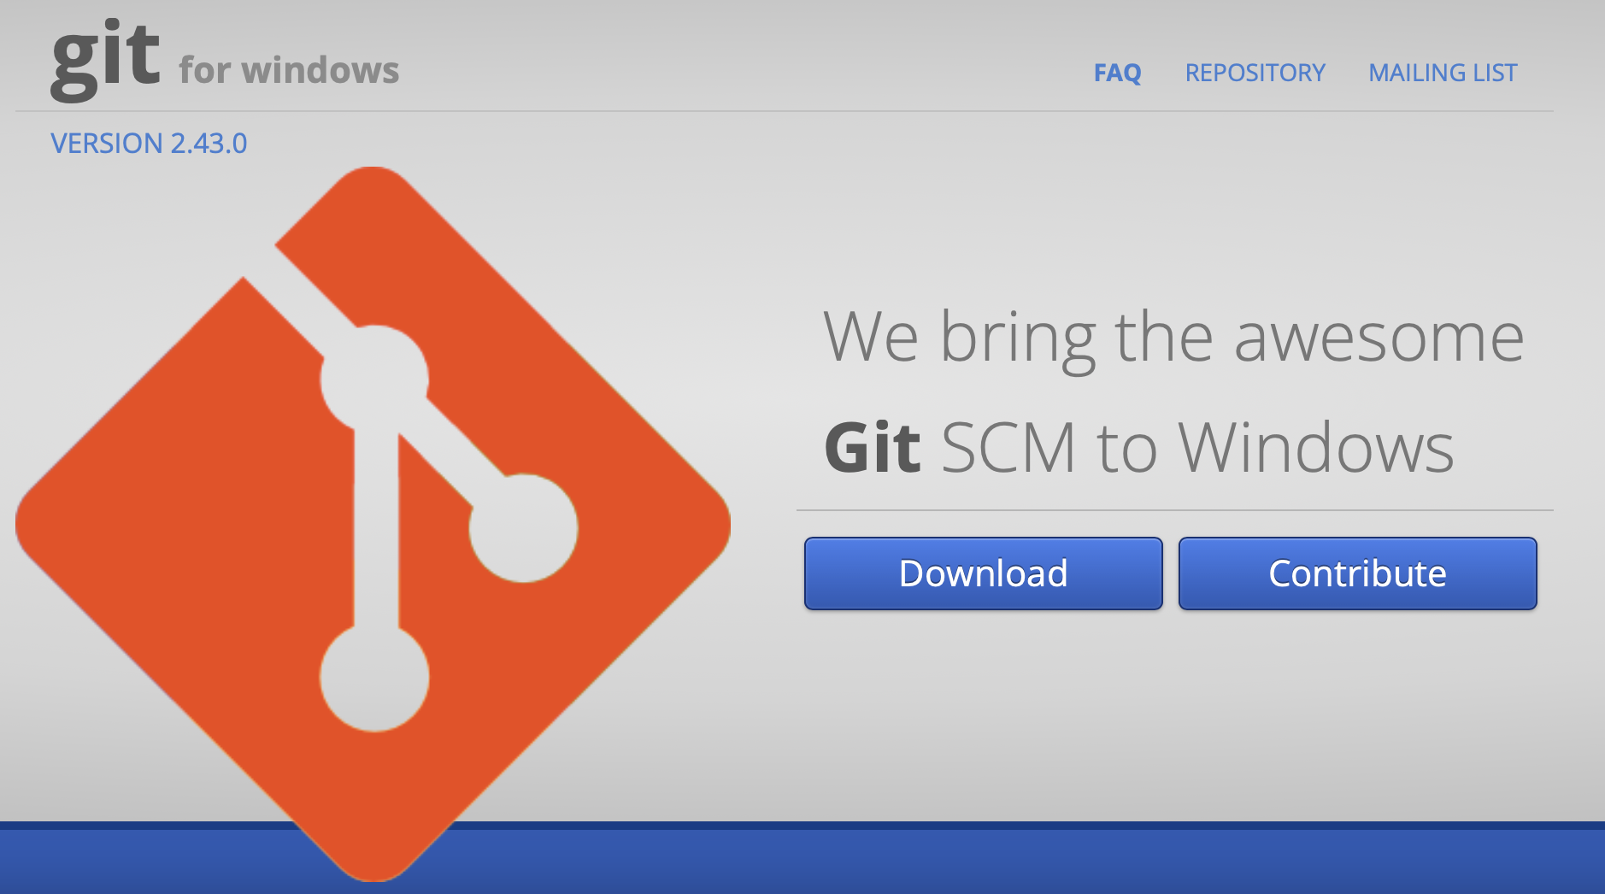
Tutorial – Set Up
Navigate to github.com and create a username
Download and install git (git-scm.com)
Download a GUI (git-scm.com/downloads/guis)
Easiest to start with github desktop (desktop.github.com)
Windows users: download git BASH (gitforwindows.org)

Slide 21
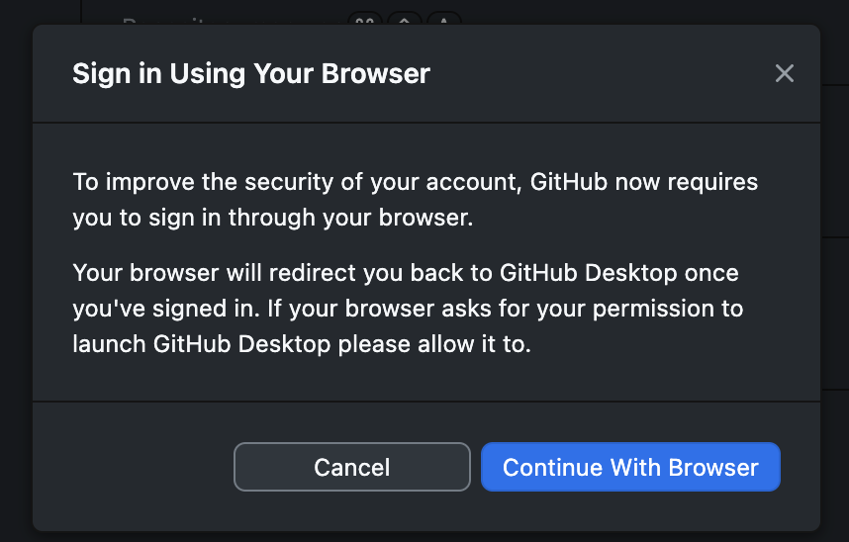
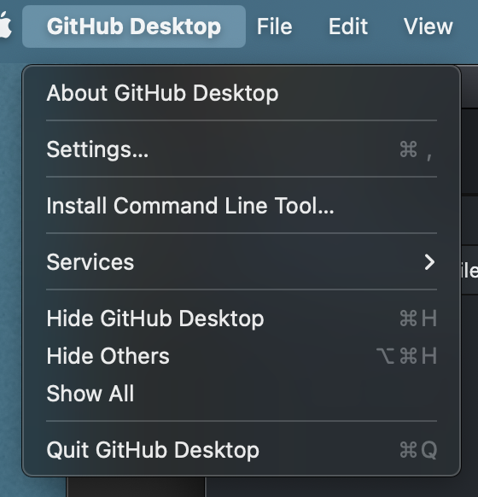
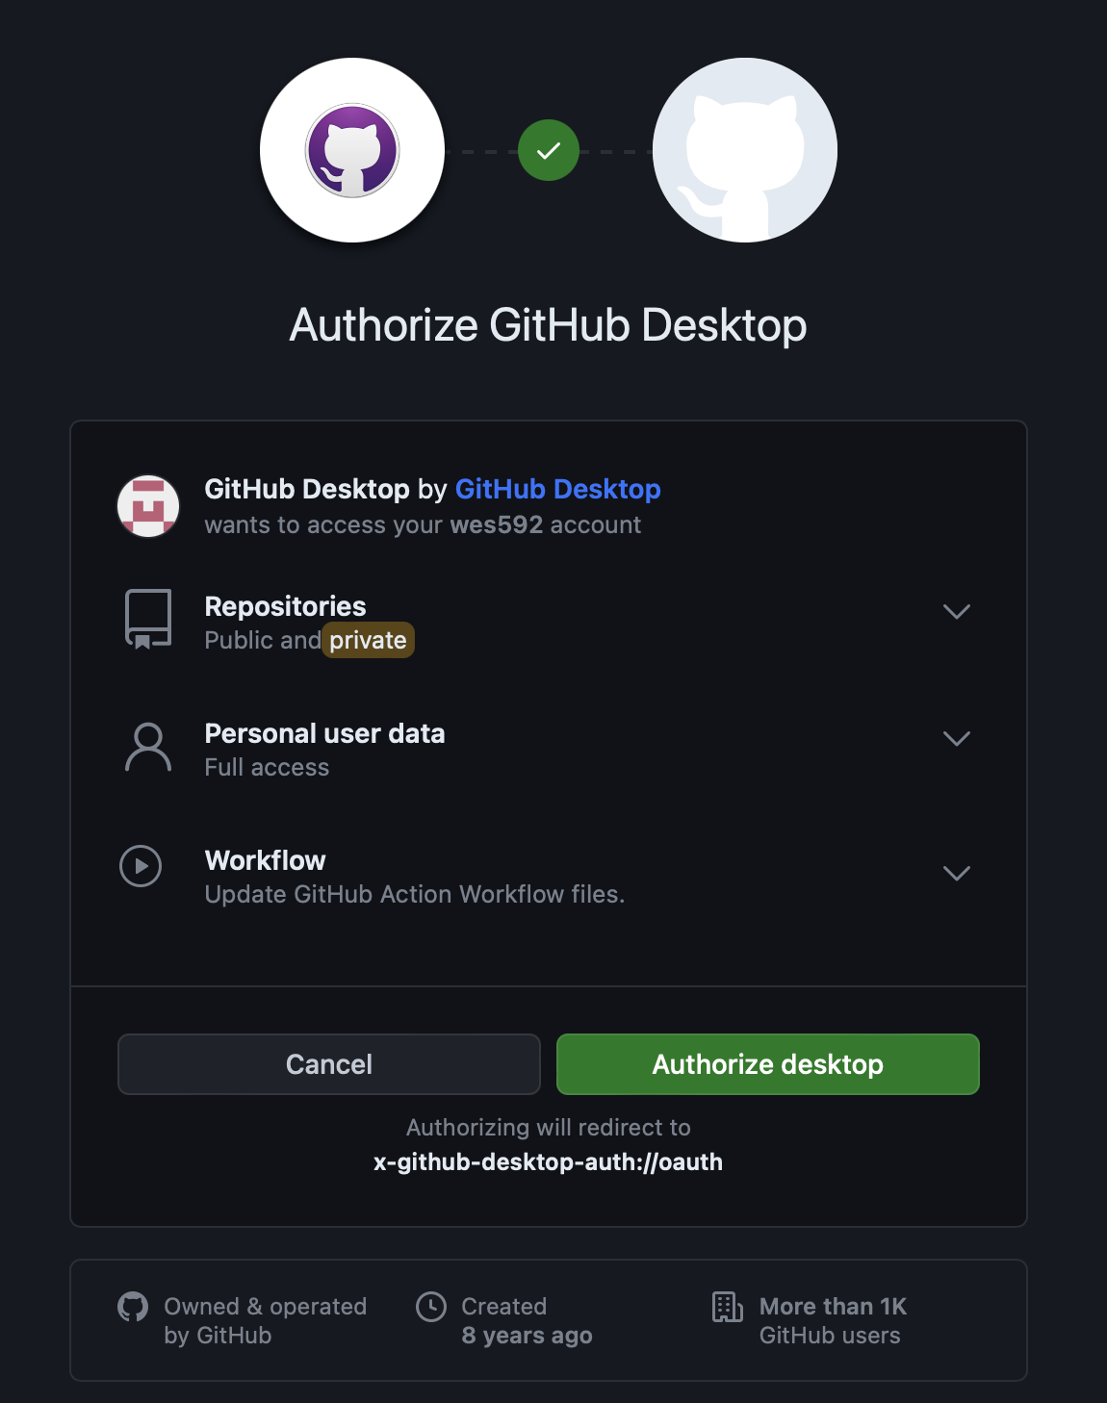
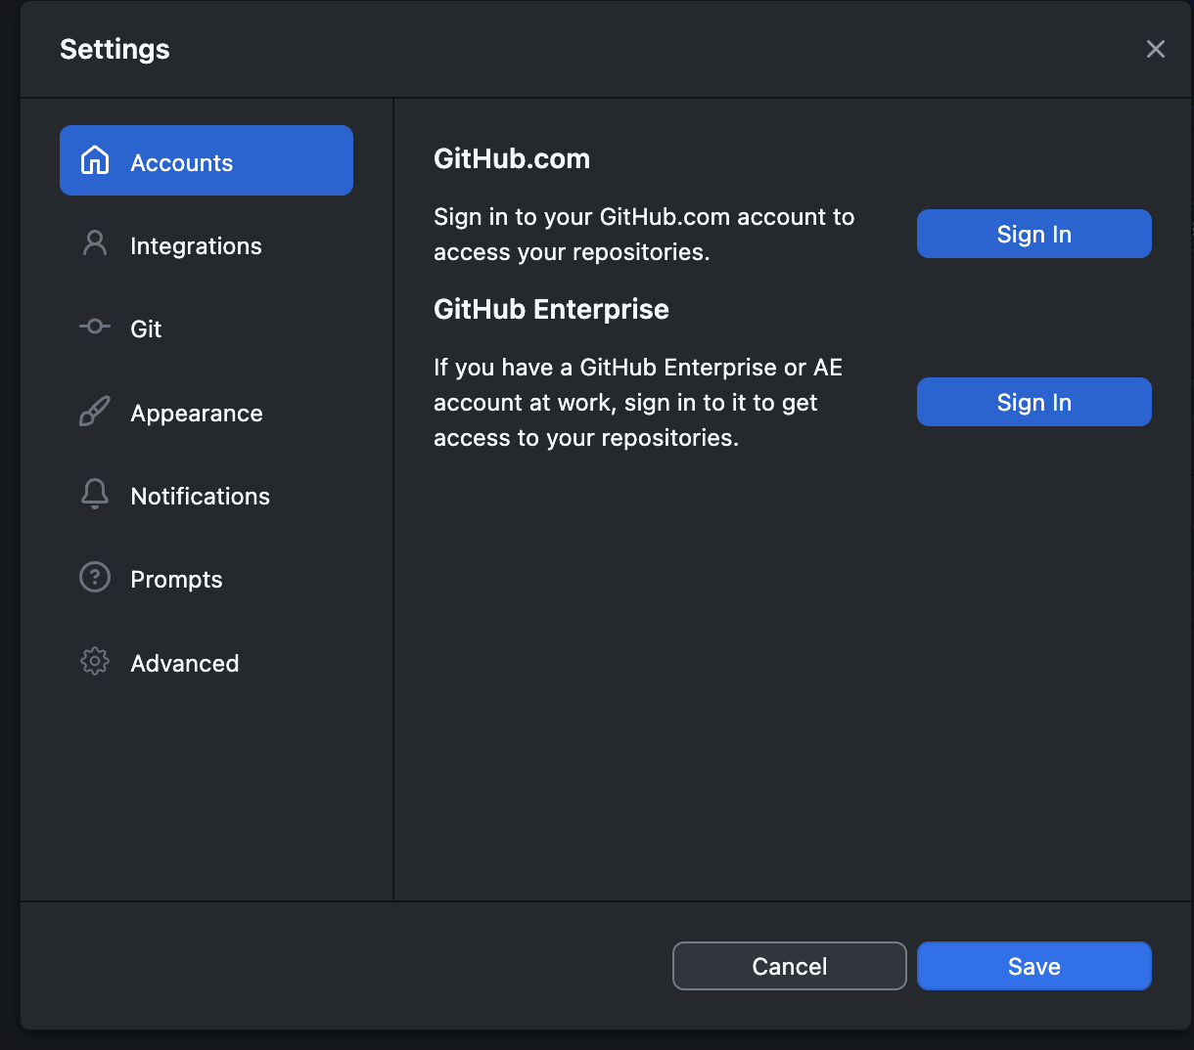
Tutorial – Initialize
Command Line:
Add your info to the config file (command line)
Authenticate GitHub Desktop

Slide 22
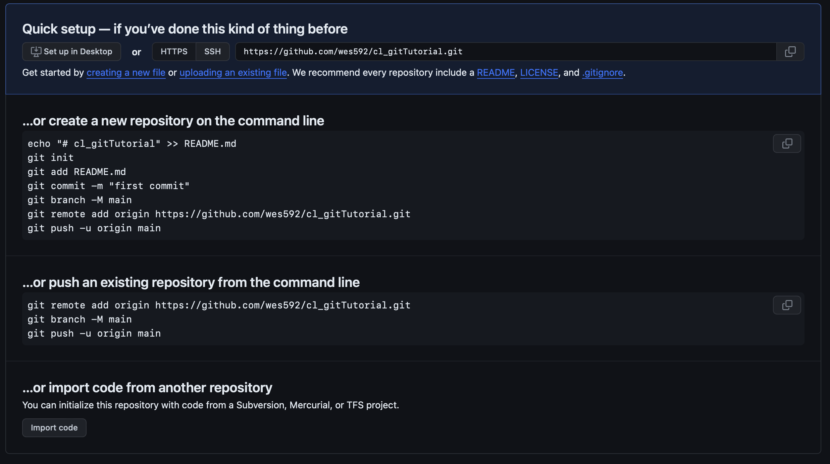
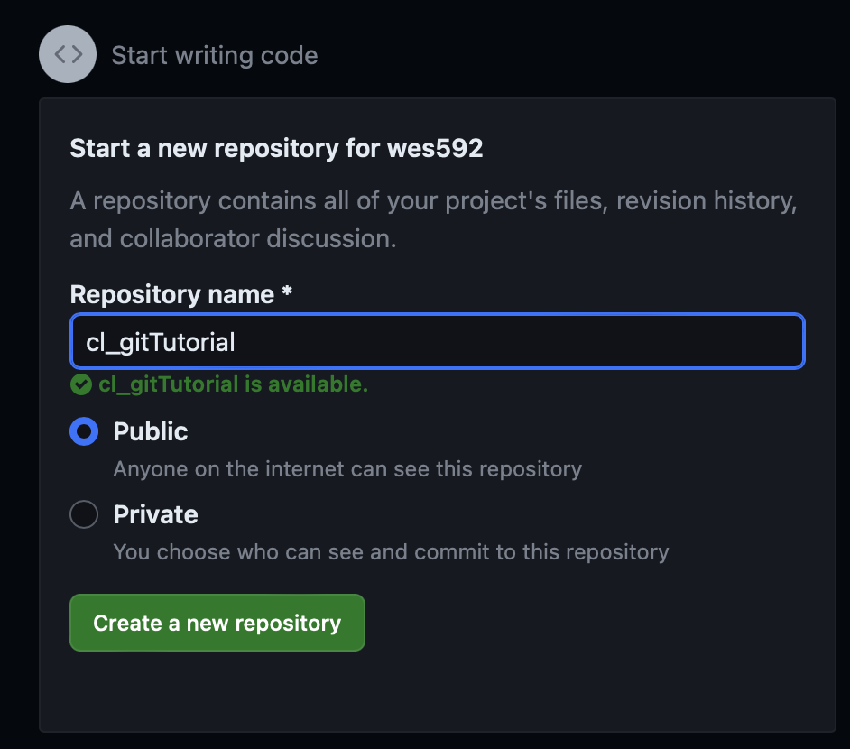
Tutorial – Access
Create your own repository
Clone an existing repository

Slide 23
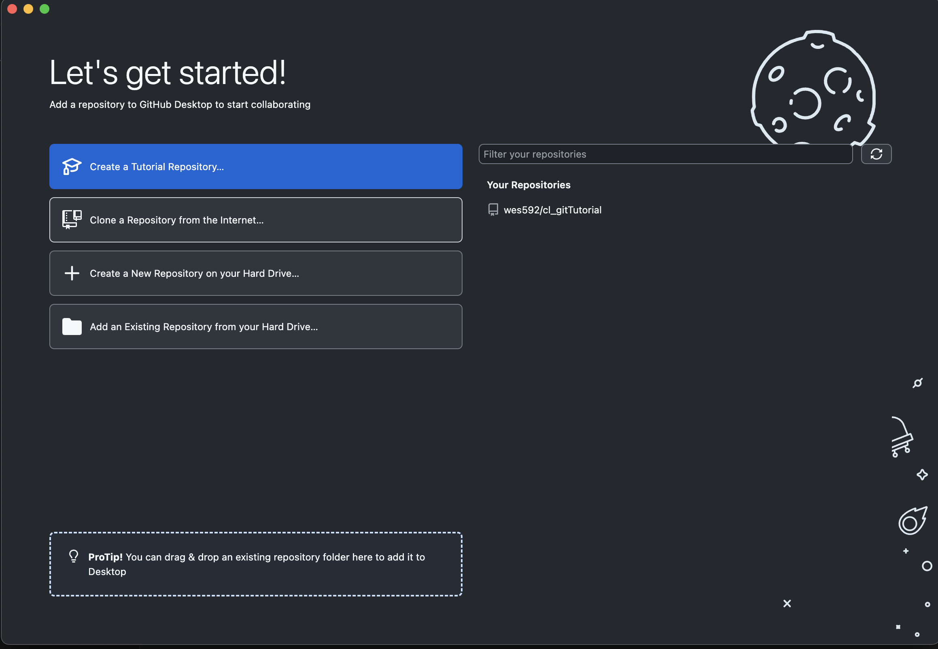
Tutorial – Access
Create your own repository
Clone an existing repository

Slide 24
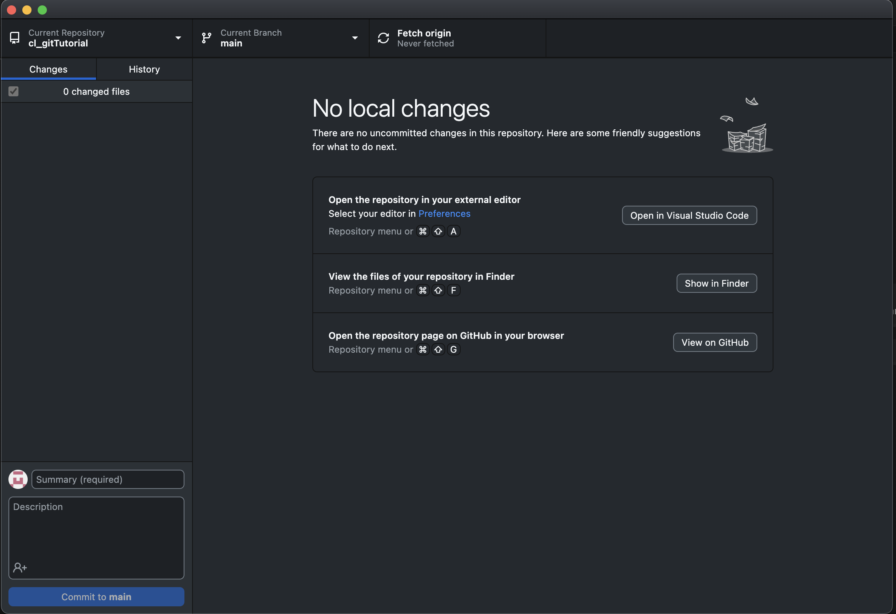
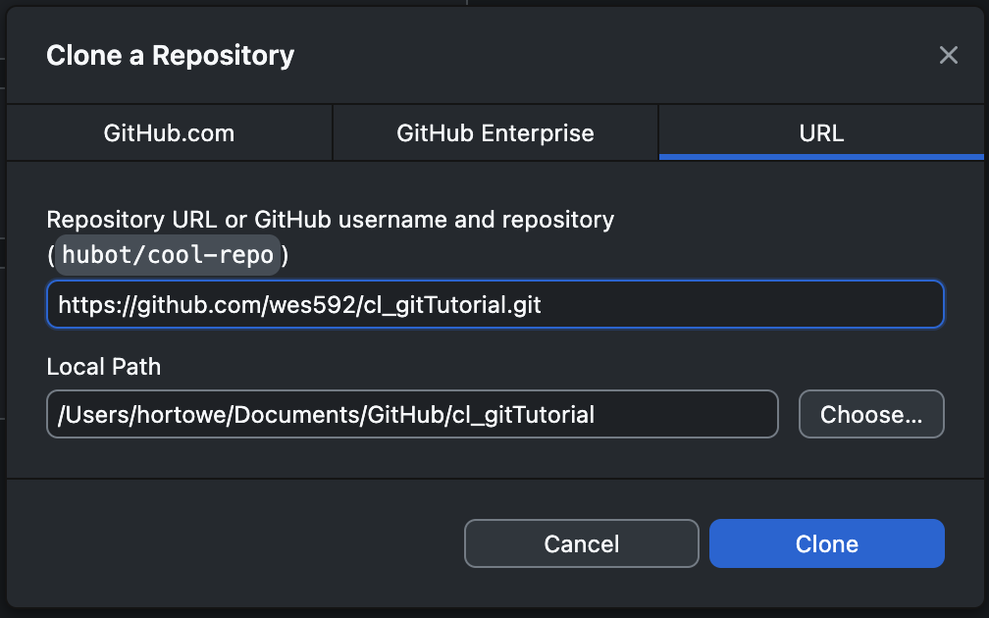
Tutorial – Access
Create your own repository
Clone an existing repository

Slide 25
Tutorial – Make a Change

Slide 26
Resources

